Slide 1

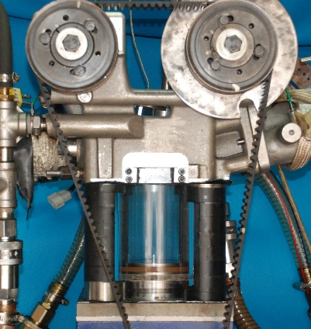
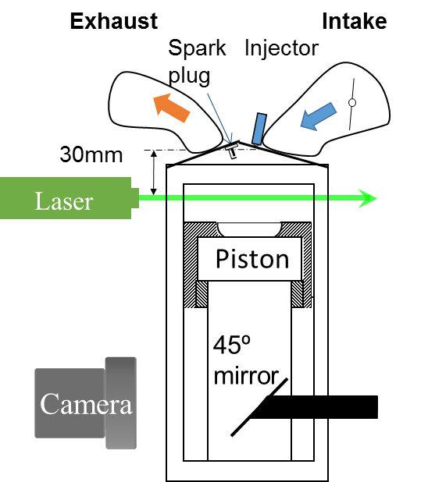
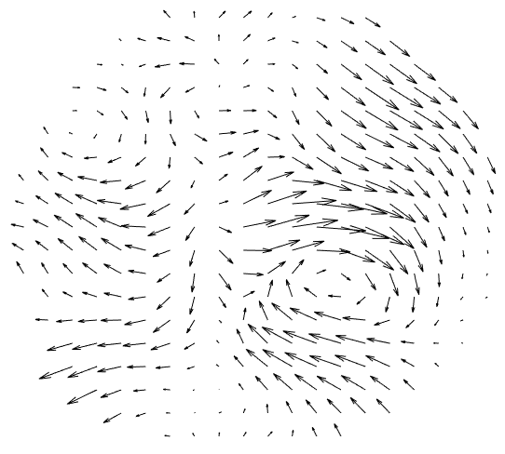
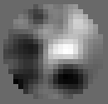

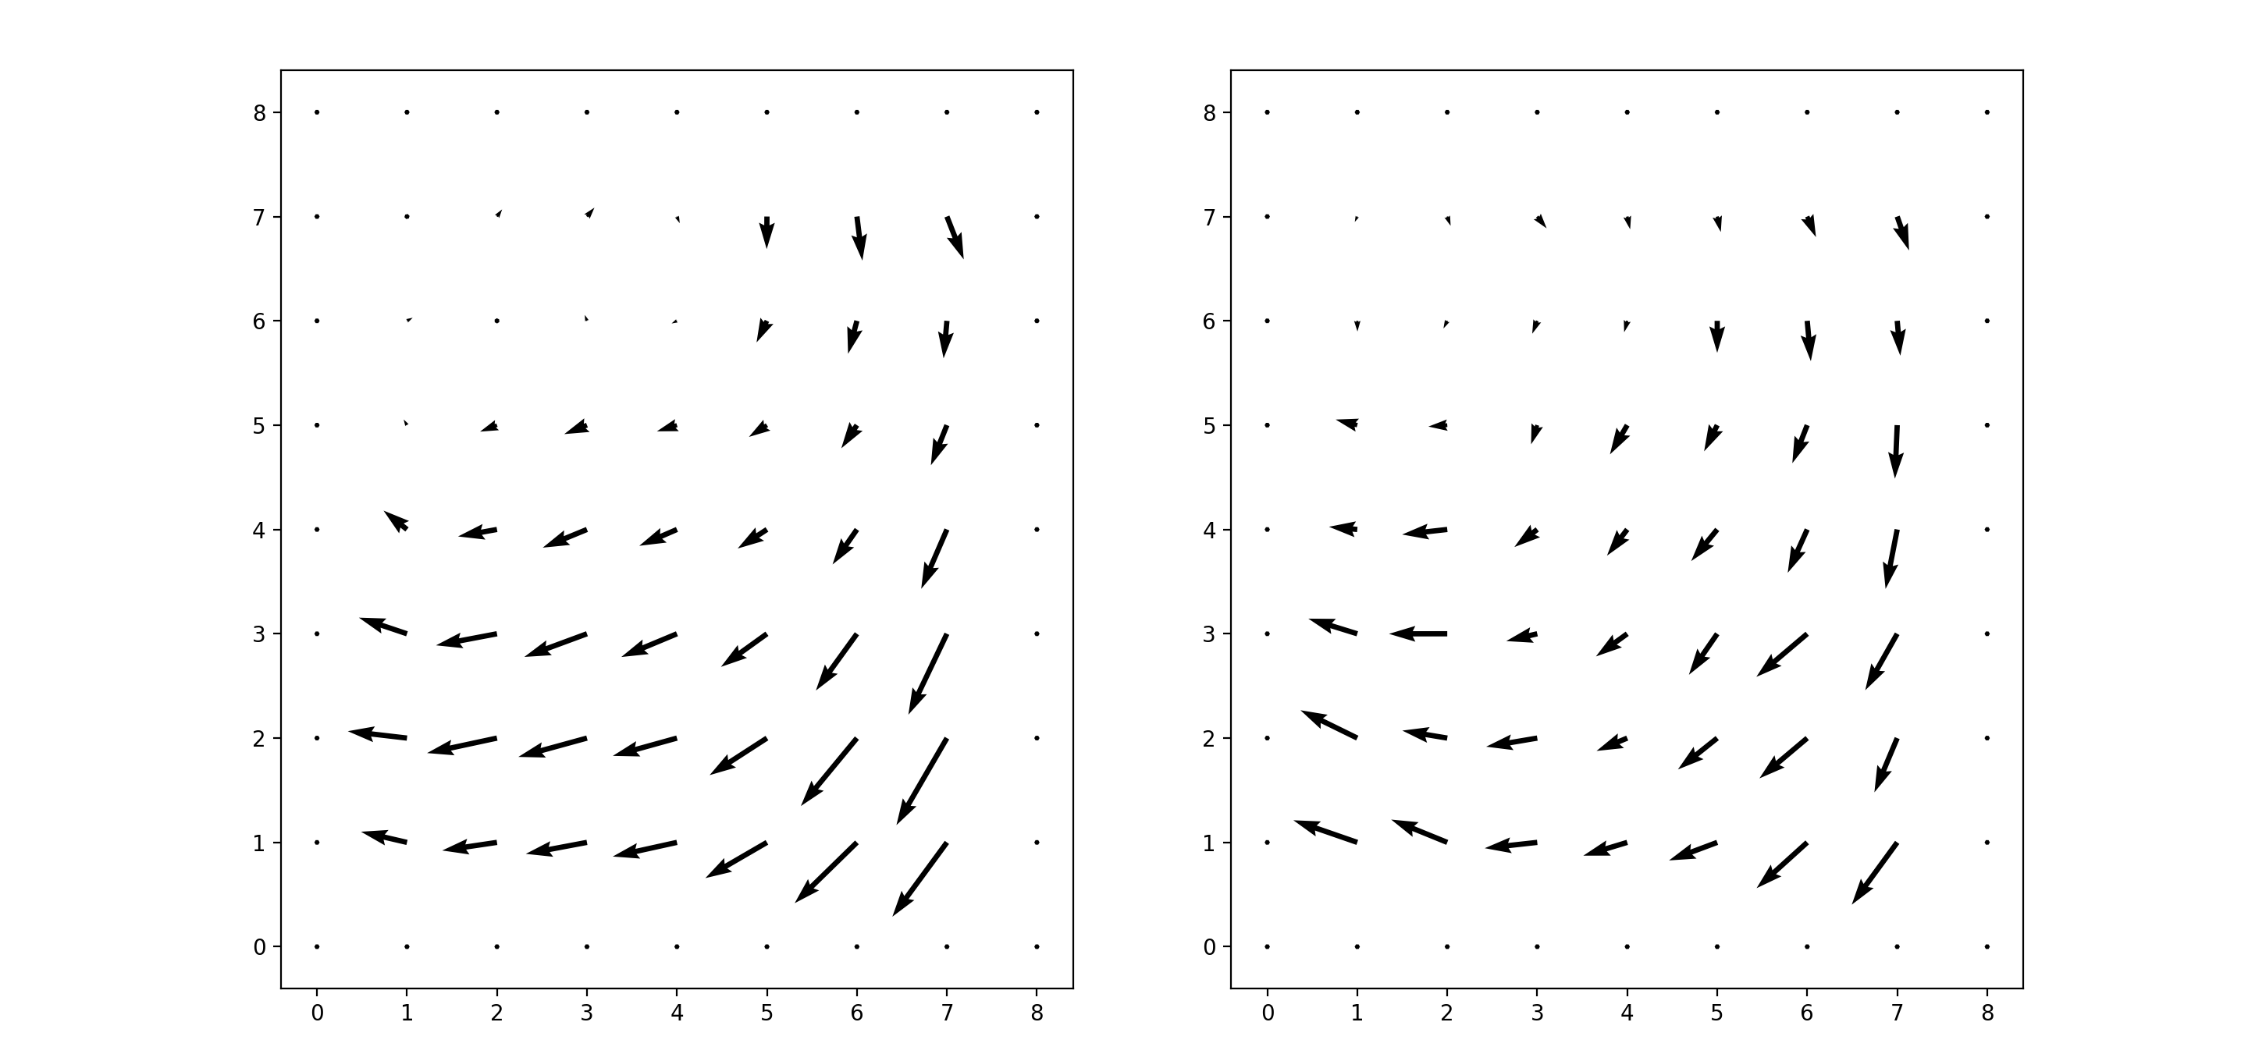
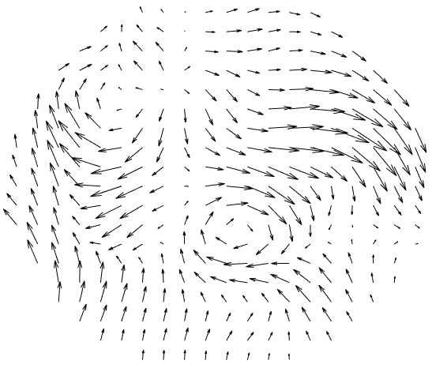
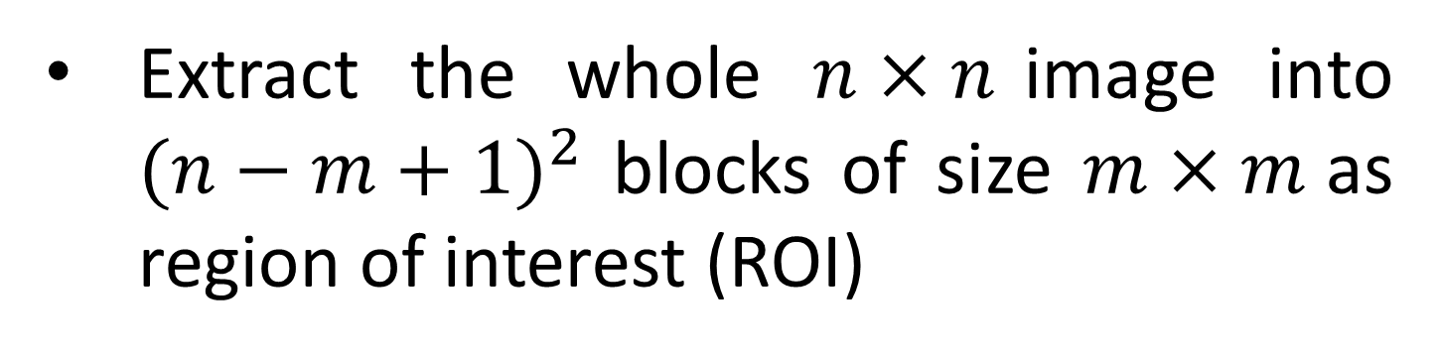
Application of Machine Learning and Artificial Intelligence Techniques on Velocity Flow Field Pattern Recognition and Prediction
Author: Fengnian Zhao, Zhiming Ruan, Chen Guo, Penghui Ge
Advisor: David Hung
UM-SJTU Joint Institute, Shanghai Jiao Tong University
RESEARCH BACKGROUND
EXPERIMENTAL SETUP AND SCHEMATIC
In-cylinder air flow structure makes significant impacts on fuel spray dispersion, fuel mixture formation, and flame propagation in spark ignition direct injection (SIDI) engines. While the flow field patterns and their transient characteristics are difficult to identify due to diversity, deep learning techniques, based on convolutional neural network (CNN) and recurrent neural network (RNN) models, can extract these specific features in an intuitive and efficient way.
Optical Engine
PIV* measurements
OBJECTIVES
Vortex structure recognition and analysis:
Vortex center location, rotation direction and size.
Flow field movement prediction:
Predict flow field movement based on data of previous flow fields.
*PIV: Particle image velocimetry, which is using the particle displacement between two temporally adjacent frames of a image pair to calculate gas phase flow motion velocity distribution.
VORTEX RECOGNITION
FLOW FIELD PREDICTION
METHODOLOGY
PROCESSES
METHODOLOGY
PROCESSES
R-CNN (Region with Convolutional Neural Network Feature) model
Input image
Autoencoder:
Autoencoder will be applied to compress the input flow fields with least amount of drains on information so that them can be represented by 1D vectors with smaller size.
Autoencoder:
Prediction:
Treat flow fields as two grayscale images
Extract the first block
3D matrix
Sequential flow field inputs
X-axis
Region of Interest (ROI)
Flatten
By autoencoder
Check the feature of ROI with CNN models and output corresponding label
1D vector
Compressed vector representation
Move to next block
RNN(Recurrent Neural Network):
RNN model is a deep learning model that has memory. It can take sequential inputs and perform prediction or classification on more than one inputs.
Several neural network layers
No
All blocks checked
Smaller 1D vector
By RNN
Y-axis
Yes
Compressed vector representation
Extract the whole $n×n$image into ${(n−m+1)}^{2}$ blocks of size $m×m$as region of interest (ROI)
A matrix of all output labels
Reverse convolution
RESULT AND DISCUSSION
Integrate & analyze information
3D matrix
By Reconstructor
Vortex Center & Direction Identification
Note: We want the final output close to the input as much as possible!
Final predicted flow field
R-CNN model:
Size of input image: 25×25. Size of ROI: 7×7.
Two CNN models ( one to judge whether there is a vortex center, and the other to identify the location and direction)
RESULT AND DISCUSSION
Result: The model works perfect for general vortexes and can identify some special vortex centers which is close to the edge of the image.
Vortex Size Recognition
R-CNN model:
Size of input image: 25×25. Size of ROI: 5×5.
One CNN models to decide whether it is a part of a vortex.
True flow field
Predicted flow field
A special case:
Incomplete vortex
Generally, prediction loss is very small. But the prediction about vectors that have small magnitude is not so good as that on vectors with great magnitude.
Result: The R-CNN model can identify
general complete vortexes
incomplete vortexes
vortexes whose centers are very close to the edge of the image or outside the image
region whose shape is like a vortex, but the magnitude and direction details are not satisfied
CONTRIBUTION
The deep learning methodology to predict the flow field movement is fast and accurate once the model is full-trained. It can be adapted to real engines which could control intake fluid to avoid energy drain based on the prediction given by the model.
The prediction model can also be used to overcome limits on experimental equipment. It can be applied as a data-mining method which generates more data at different time steps based on data we already have.
CONTRIBUTION
ACKNOWLEDGMENT
R-CNN models can recognize the location, direction and size range of the vortexes in a flow field very well.
R-CNN models considers more on the general shape of the image than the detailed velocity magnitude and direction, which may cause some errors.
The experimental work is implemented in the Institute of Automotive Engineering of Shanghai Jiao Tong University and sponsored by General Motors Global R&D.

